Slide 1

APPLIED DATA SCIENCE PORTFOLIO
VISHWANATH HEGDE

Slide 2

What did you learn?
Whitman School of Management
Courses Taken: MBC 638, SCM 651, SCM 702
Learnt Statistical concepts such as sampling, distribution, variance, hypothesis testing, confidence, statistical significance, correlation, chi-Square, regression linear and non-linear, logistic
Optimization such as constrained and unconstrained optimization to handle demand and supply side of economics
Used techniques which have useful business applications such as optimization of investment, comparing two sample populations, network flow models and decision analysis
School of Information Studies
Courses Taken: IST 687, IST 651, IST 659, IST 707, IST 724, IST 736,IST 719, IST 718
Programming Languages such as R, Python, SQL, PySpark
Data mining techniques such as data extraction, cleaning, manipulation, exploratory data analysis and ML prediction
Database Management and analyzing database access to make it more secure
Tools such as Visio, Adobe Illustrator, Weka, R commander
ML Concepts such as regression, SVM, random forest, time series, naïve bayes and Neural Networks
Notes:
Notes to presenter:
Description of what you learned in your own words on one side.
Include information about the topic
Details about the topic will also be helpful here.
Tell the story of your learning experience. Just like a story there should always be a beginning, middle and an end.
On the other side, you can add a graphic that provides evidence of what you learned.
Feel free to use more than one slide to reflect upon your process. It also helps to add some video of your process.

Slide 3
Collecting Data
Partial List of Data Sources
KAGGLE website: https://www.kaggle.com/
Centers for disease control and prevention: https://www.cdc.gov/nchs/data-visualization/index.htm
Yahoo finance: https://finance.yahoo.com/
UCI repository: https://archive.ics.uci.edu/ml/index.php
Notes:
Notes to presenter:
What did you think at first?
What obstacles did you encounter along the way?
How did you overcome those obstacles?
What images can you add to support your process?
This SmartArt allows you add images and text to help outline your process. If a picture is worth a thousand words, then pictures and words should help you communicate this reflection on learning perfectly! You can always click on Insert>SmartArt to change this graphic or select the graphic and click on the Design contextual menu to change the colors.
Feel free to use more than one slide to reflect upon your process. It also helps to add some video of your process.

Slide 4
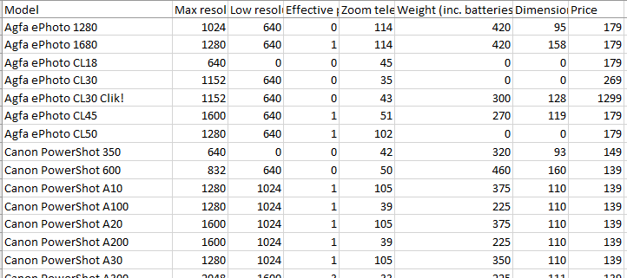
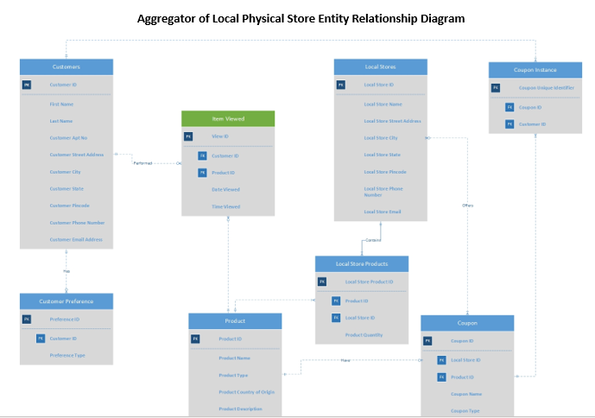
Organizing Data
Notes:
Notes to presenter:
What did you think at first?
What obstacles did you encounter along the way?
How did you overcome those obstacles?
What images can you add to support your process?
This SmartArt allows you add images and text to help outline your process. If a picture is worth a thousand words, then pictures and words should help you communicate this reflection on learning perfectly! You can always click on Insert>SmartArt to change this graphic or select the graphic and click on the Design contextual menu to change the colors.
Feel free to use more than one slide to reflect upon your process. It also helps to add some video of your process.

Slide 5
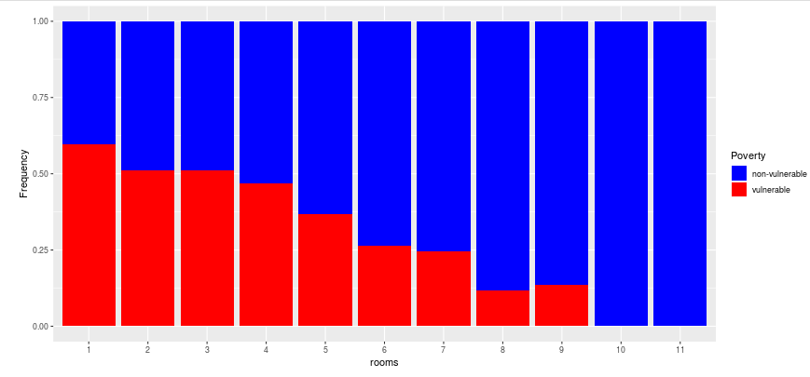
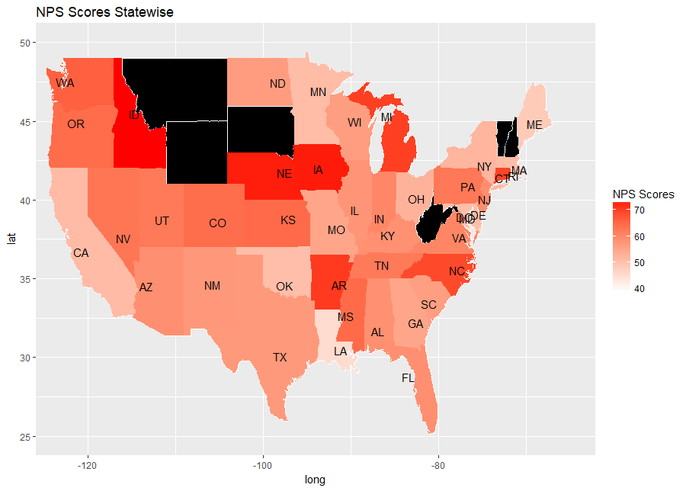
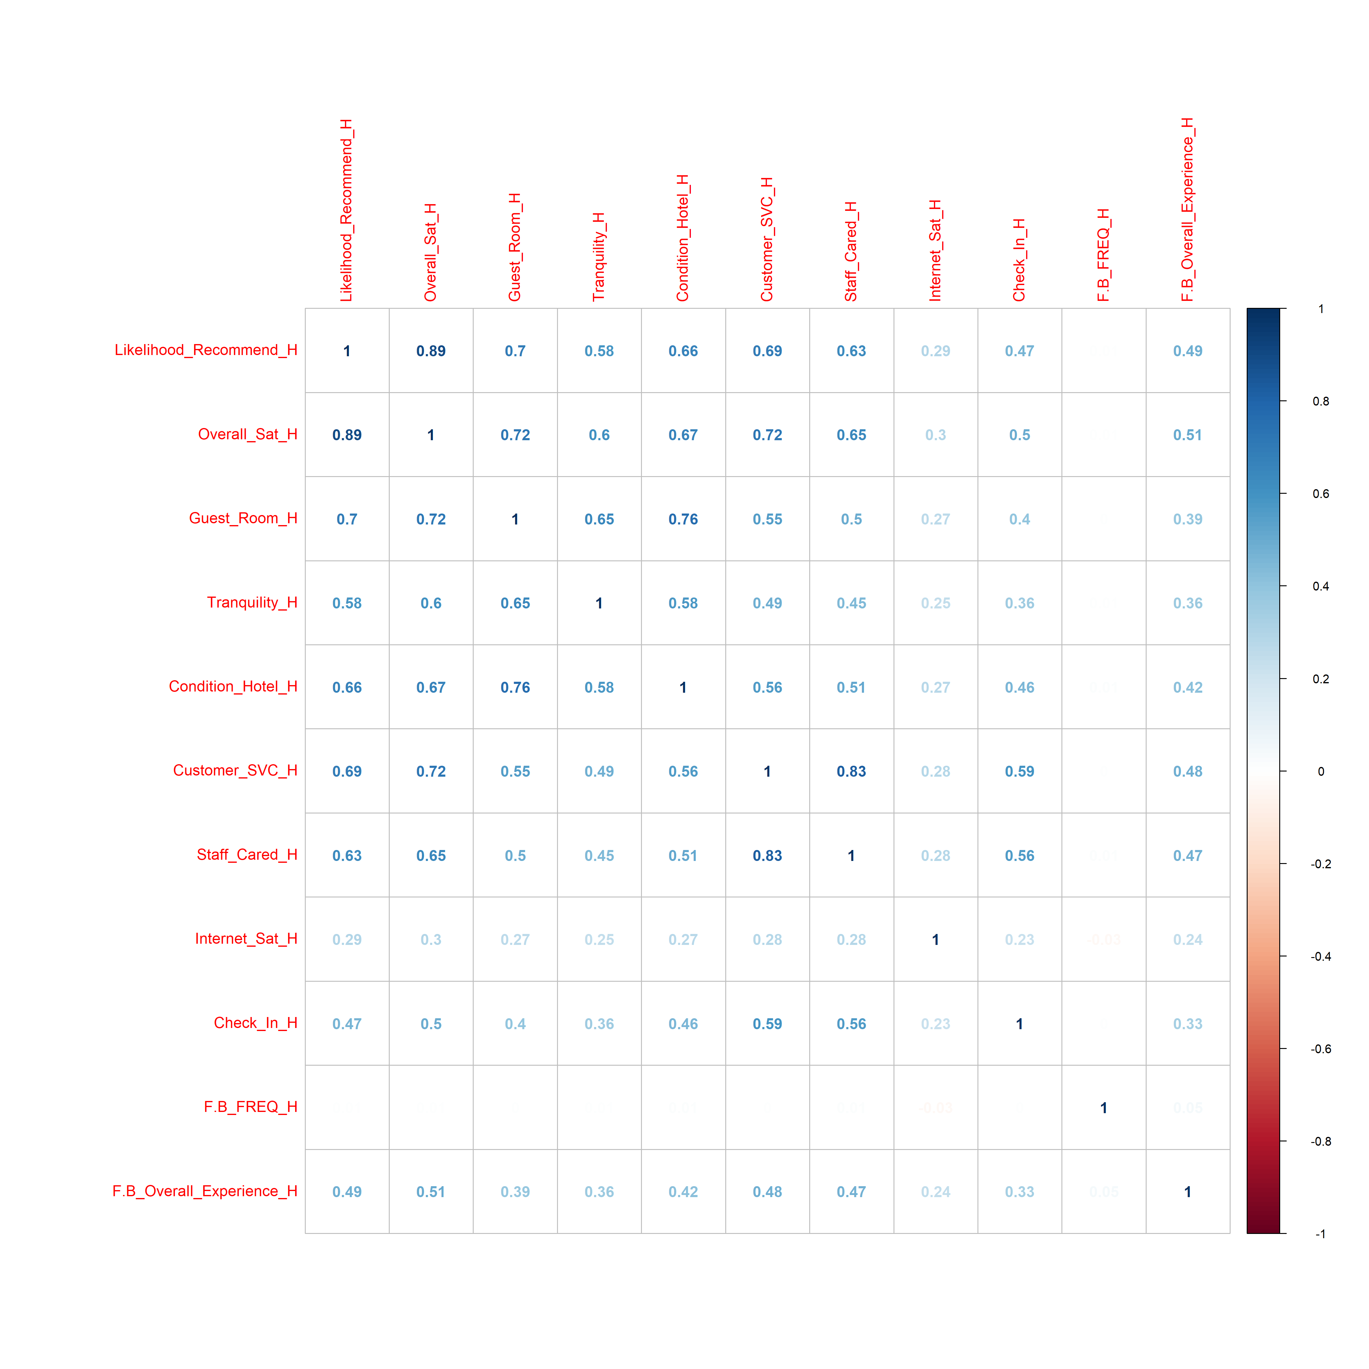
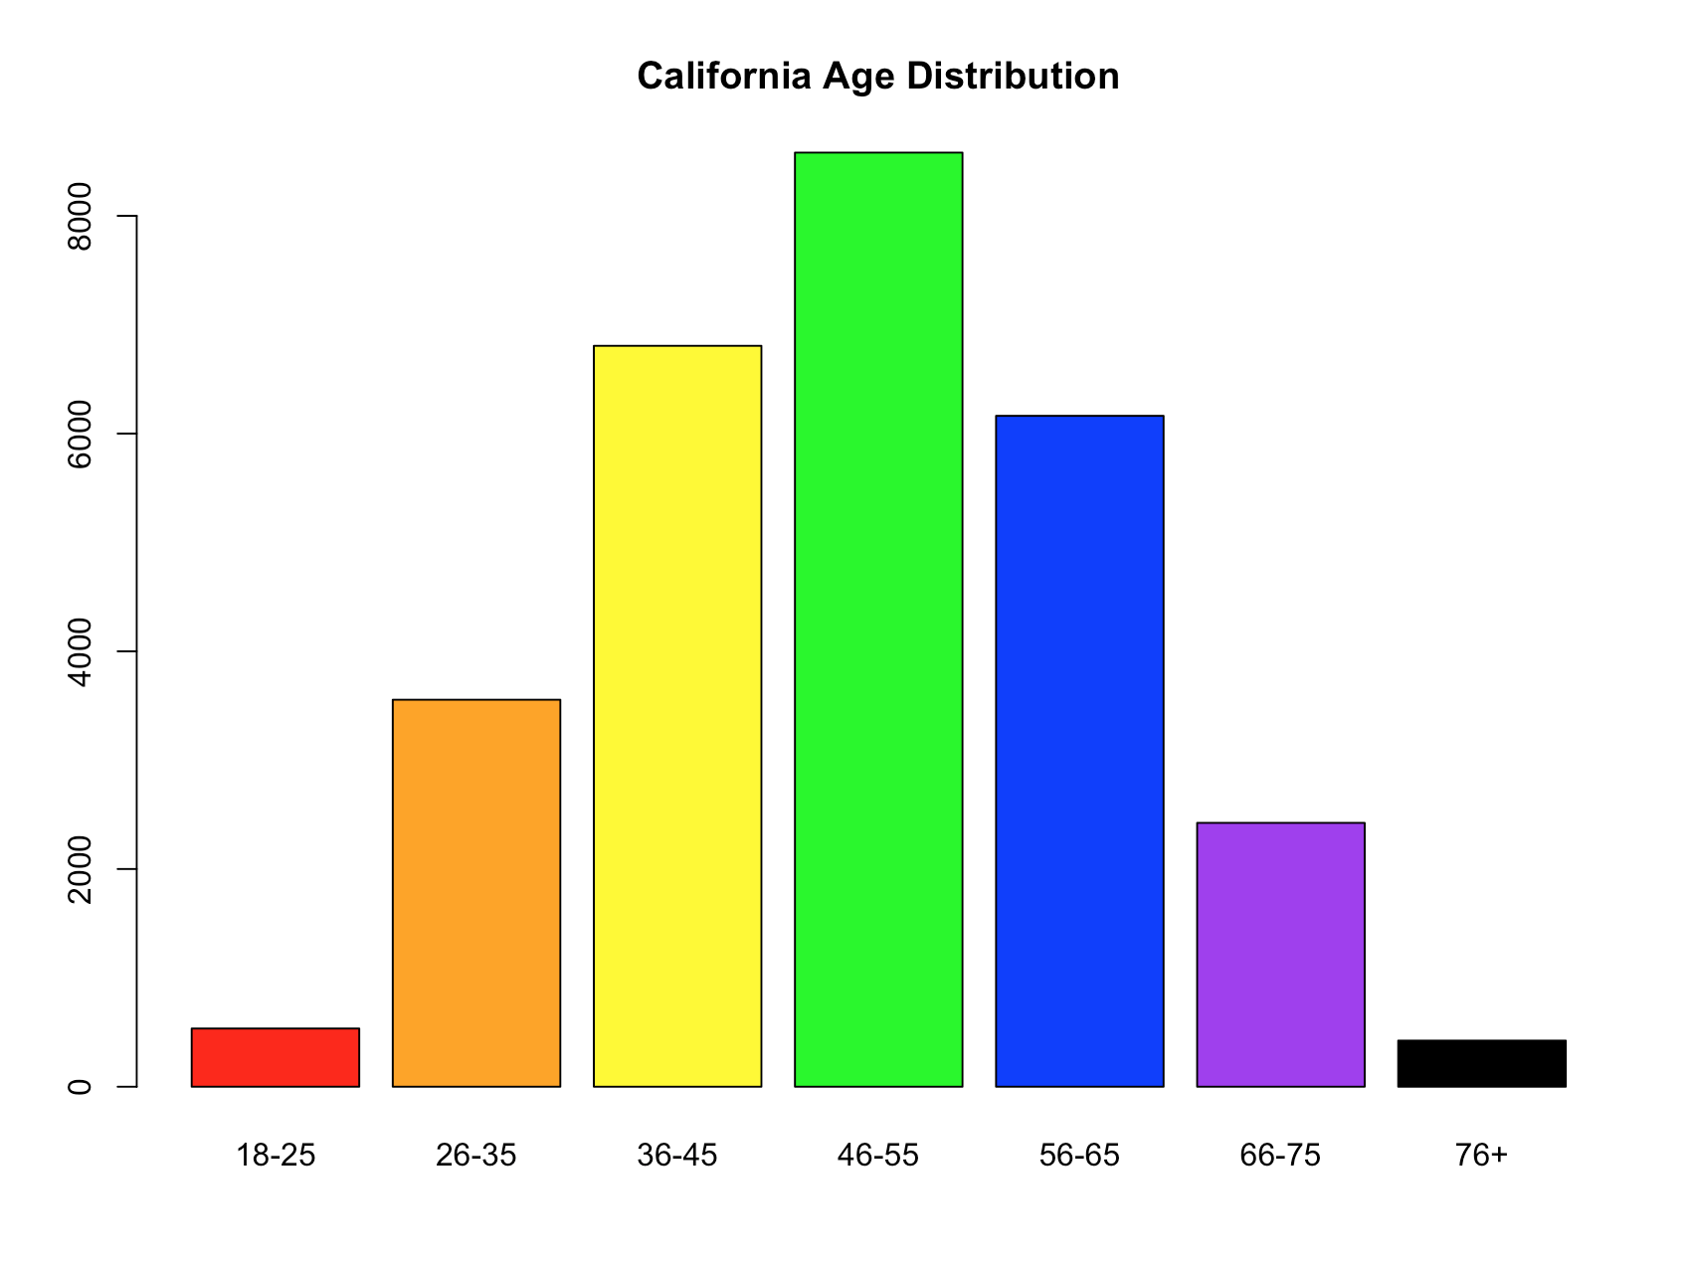
Analysis and Visualization of Data
Notes:
Notes to presenter:
What did you think at first?
What obstacles did you encounter along the way?
How did you overcome those obstacles?
What images can you add to support your process?
This SmartArt allows you add images and text to help outline your process. If a picture is worth a thousand words, then pictures and words should help you communicate this reflection on learning perfectly! You can always click on Insert>SmartArt to change this graphic or select the graphic and click on the Design contextual menu to change the colors.
Feel free to use more than one slide to reflect upon your process. It also helps to add some video of your process.

Slide 6
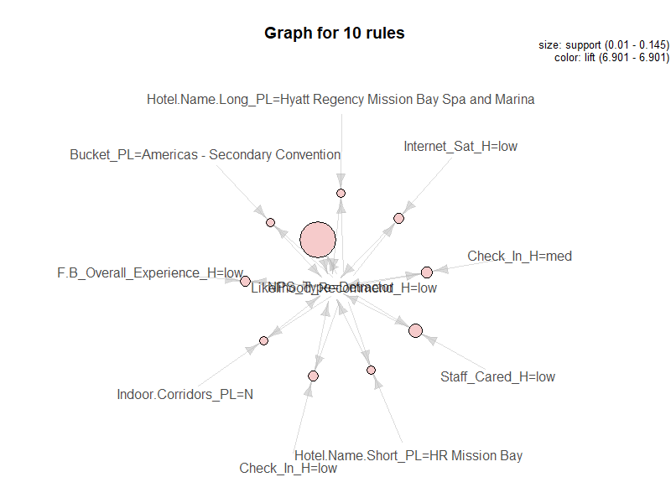
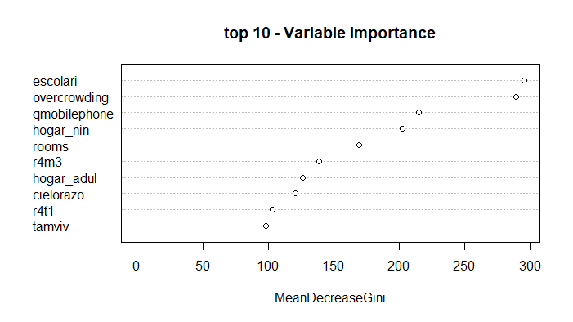
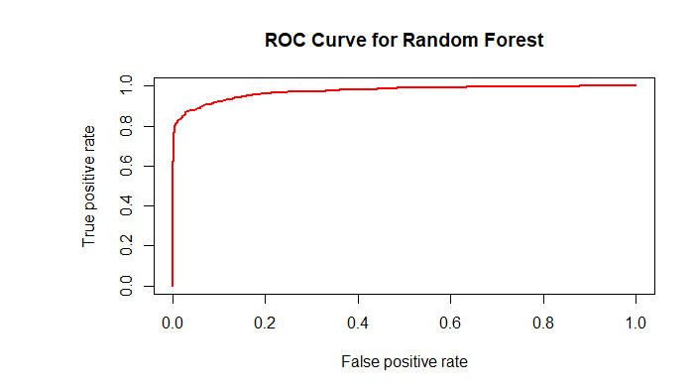
Data Mining and Business Recommendations
Notes:
Notes to presenter:
What did you think at first?
What obstacles did you encounter along the way?
How did you overcome those obstacles?
What images can you add to support your process?
This SmartArt allows you add images and text to help outline your process. If a picture is worth a thousand words, then pictures and words should help you communicate this reflection on learning perfectly! You can always click on Insert>SmartArt to change this graphic or select the graphic and click on the Design contextual menu to change the colors.
Feel free to use more than one slide to reflect upon your process. It also helps to add some video of your process.

Slide 7
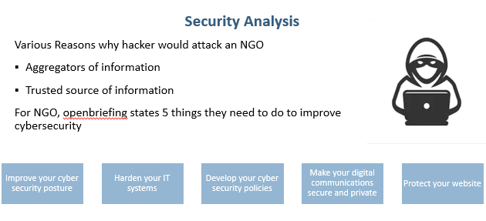
Information & Database Security
Data and system inventory
IT Risk Framework
Laws, regulations
Cybersecurity incident/breach response plan
Notes:
Notes to presenter:
What did you think at first?
What obstacles did you encounter along the way?
How did you overcome those obstacles?
What images can you add to support your process?
This SmartArt allows you add images and text to help outline your process. If a picture is worth a thousand words, then pictures and words should help you communicate this reflection on learning perfectly! You can always click on Insert>SmartArt to change this graphic or select the graphic and click on the Design contextual menu to change the colors.
Feel free to use more than one slide to reflect upon your process. It also helps to add some video of your process.

Slide 8
Next Steps in Data Science Journey
Learn about training models on cloud platforms such as Google or Amazon
Focus on data mining tools such as Knime and Dataiku
Learn more about data visualization tools such as Tableau and power BI
Job Interviews so far
Terakeet – SEO Analyst
American Credit Association – Data Scientist
HorizonNext – Data Analyst
Notes:
Notes to presenter:
What did you think at first?
What obstacles did you encounter along the way?
How did you overcome those obstacles?
What images can you add to support your process?
This SmartArt allows you add images and text to help outline your process. If a picture is worth a thousand words, then pictures and words should help you communicate this reflection on learning perfectly! You can always click on Insert>SmartArt to change this graphic or select the graphic and click on the Design contextual menu to change the colors.
Feel free to use more than one slide to reflect upon your process. It also helps to add some video of your process.

Slide 9
Thank You

